Slide 1

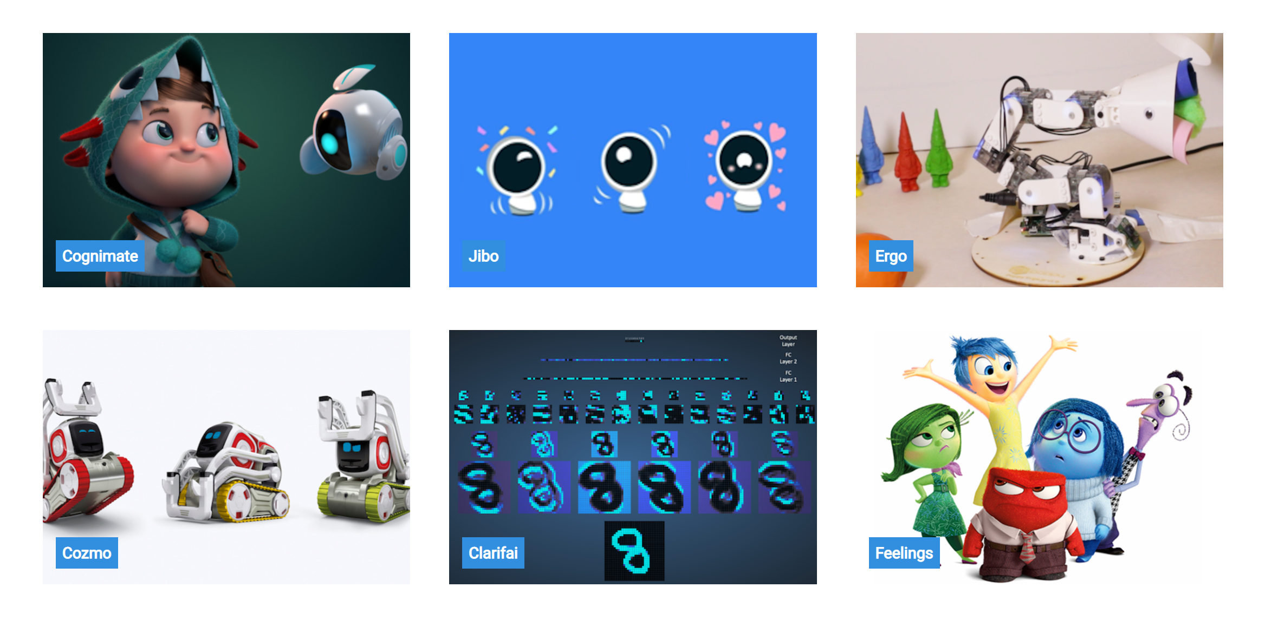
http://cognimates.me
Project creator Stefania Druga The project was supported by the Personal Robots Group at MIT Media Lab, directed by Cynthia Breazeal, Associate Professor of Media Arts and Sciences.
Link to Supplemental Slides
(Don’t assume they don’t know scratch)
Overview: Highlight the different plug-in
Speech Recognition
Image Recognition
Emotion Recognition

Slide 2
Meet the Researchers
Notes:
Add pictures & Bios - Think … Trading Cards

Slide 3
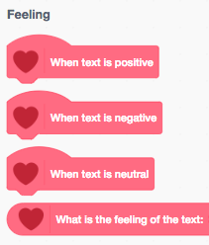
Cognimates Feelings Extension
The Feelings extension is analysing if a text is positive or negative. This extension is using the Sentiment Analysis public pre-trained library.

Slide 4
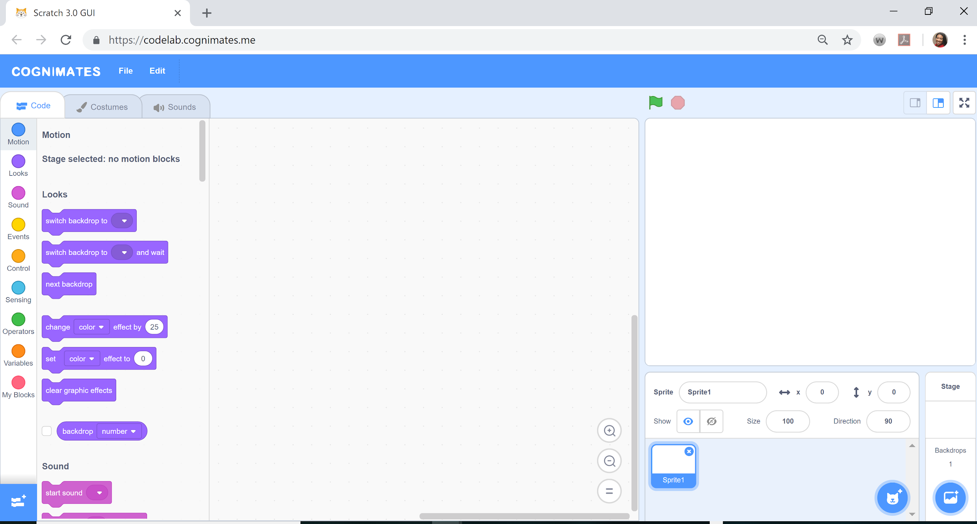
Launch Cognimates & loading extensions
https://codelab.cognimates.me/

Slide 5
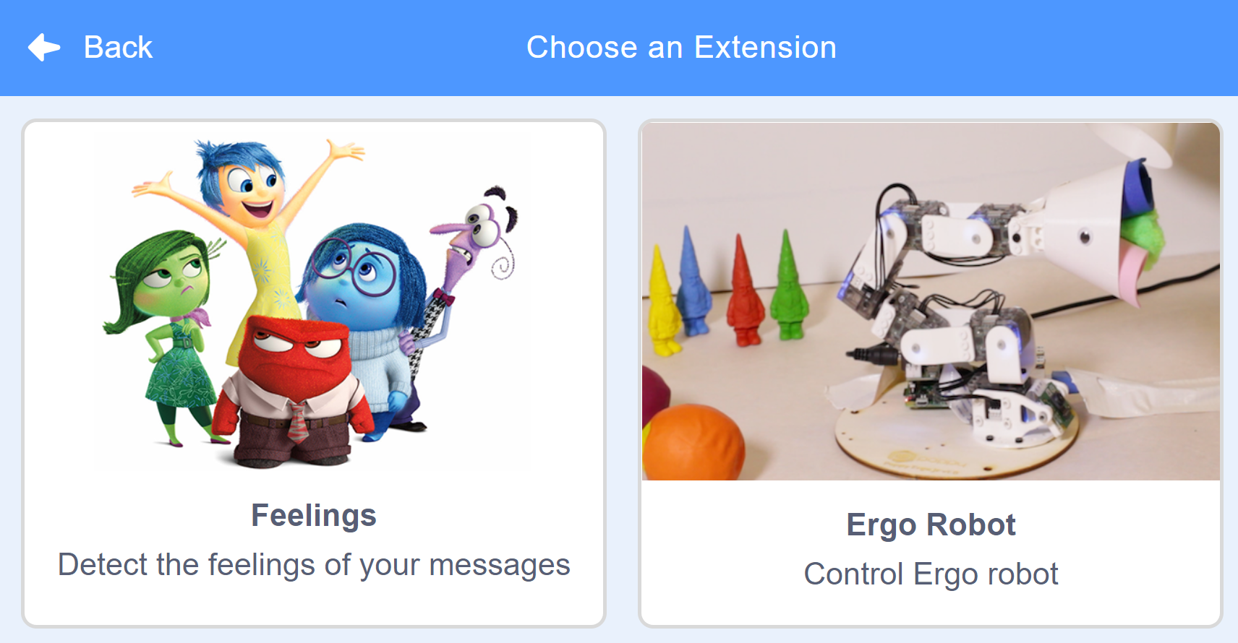
Choose an Extension

Slide 6
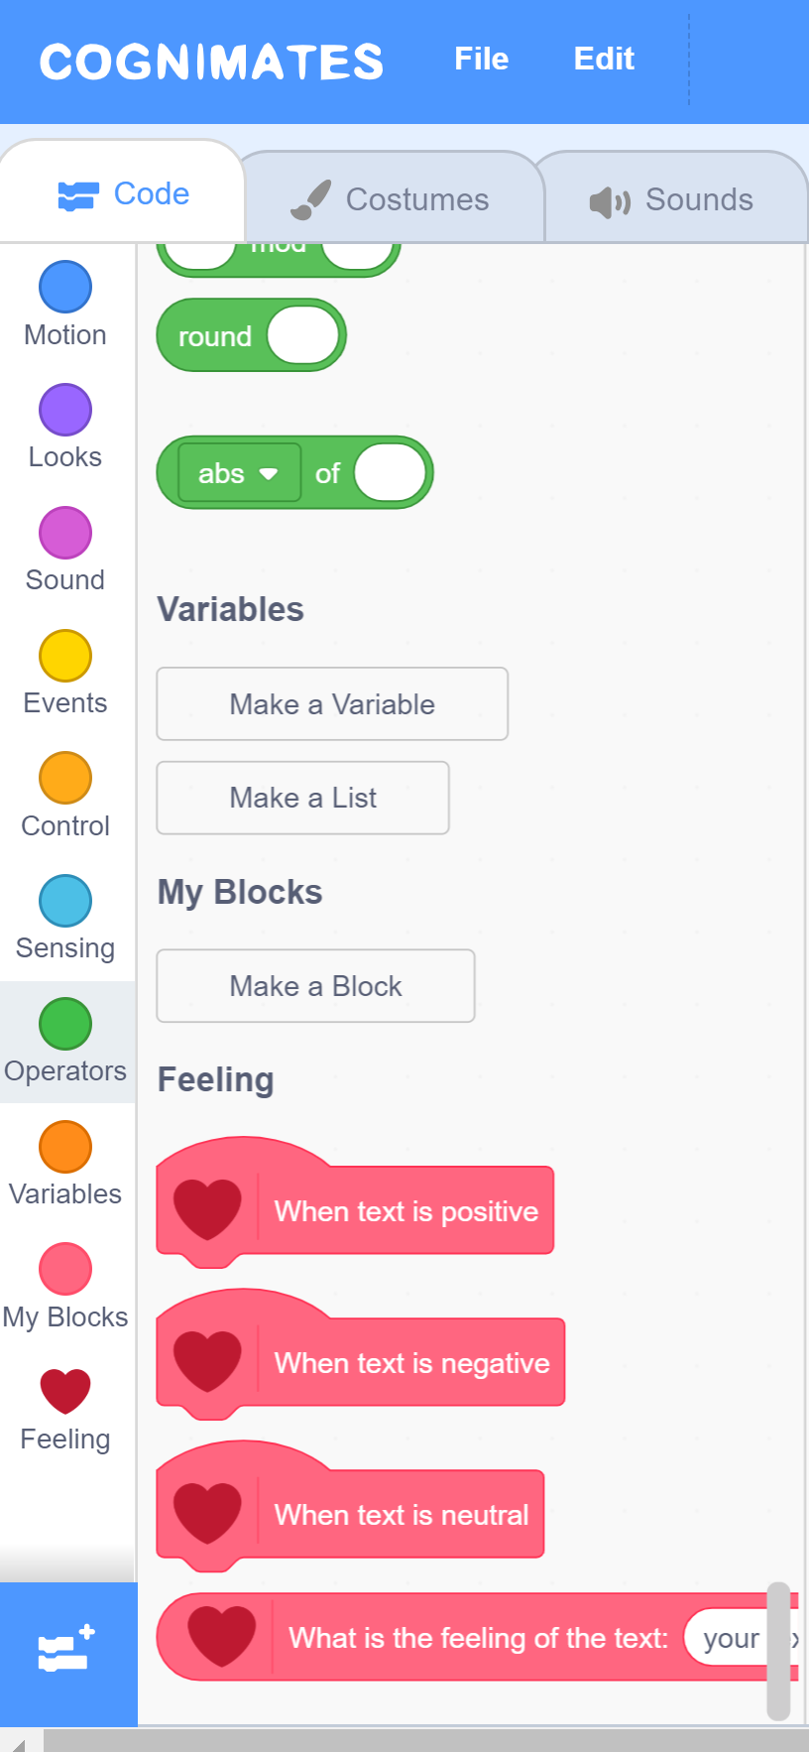
Using the Feelings Extension
Notice that the feelings extension is now added to the bottom of the block menu on the left..
When you click on the heart icon the feeling blocks pop up.

Slide 7
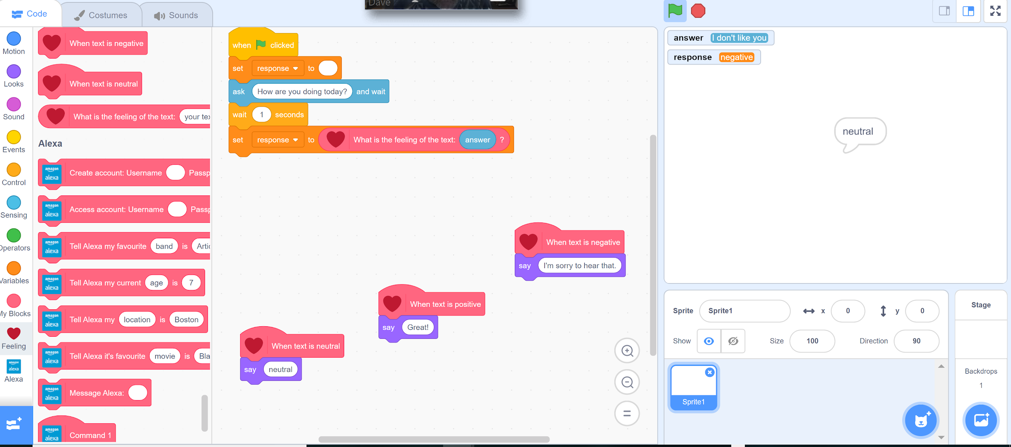
Sample Project
Create a program that will detect the emotions in messages that are typed into the program.

